Slide 1

Defensive Security Project by:
Timothy Hogan, Diana Kimondo, Kaps Kapende, Chuksie Ihezue, and Brian Briggman
(Group 3)

Slide 2



Table of Contents
This document contains the following resources:
Monitoring Environment
Attack Analysis
Project Summary & Future Mitigations

Slide 3

Monitoring Environment
‹#›

Slide 4
Scenario
We are a cybersecurity team working to secure the website of Virtual Space Industries (VSI), a small business that designs Virtual-reality programs for other businesses. We will take on the role of a SOC analyst to monitor against potential attacks on their systems and applications. This comes after a rumor of potential cyber attacks launched by a competitor (JobeCorp) to disrupt business.
Using Splunk, we will customize the environment to protect VSI’s critical infrastructure. The components we’ll be monitoring include:
○ An administrative webpage: https://vsi-corporation.azurewebsites.net/
○ An Apache web server hosting the site
○ A Windows operating system managing VSI’s backend operations
We will use past logs to establish baselines, create detailed reports, set up alerts, and develop custom dashboards to track and respond to any suspicious activity.

Slide 5
Windows Logs
‹#›

Slide 6
Reports—Windows
Designed the following reports:
Report Name | Report Description
ID Number Associated with Specific Signature | A report that shows the ID number associated with the specific signature for Windows activity.
Windows Logs Severity | A report to quickly understand the severity levels of the Windows logs being viewed.
Success and Failure - Windows | A report that will show if there is a suspicious level of failed activities on their server.

Slide 7
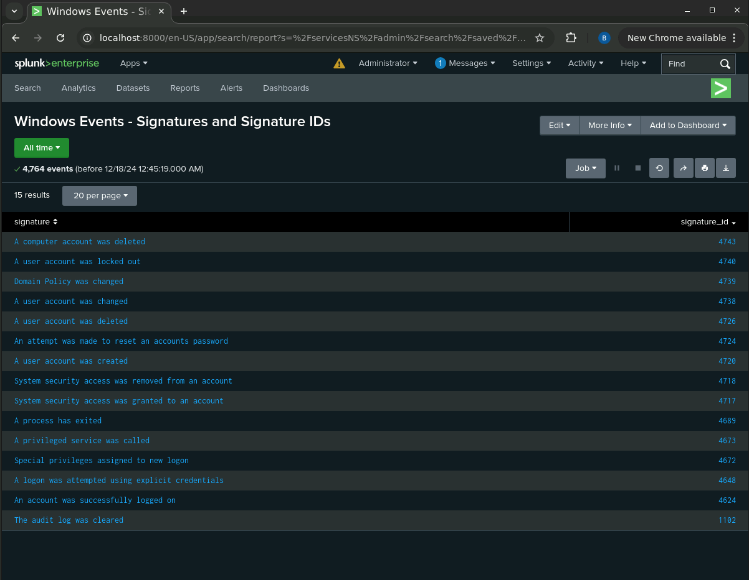
Images of Reports—Windows

Slide 8
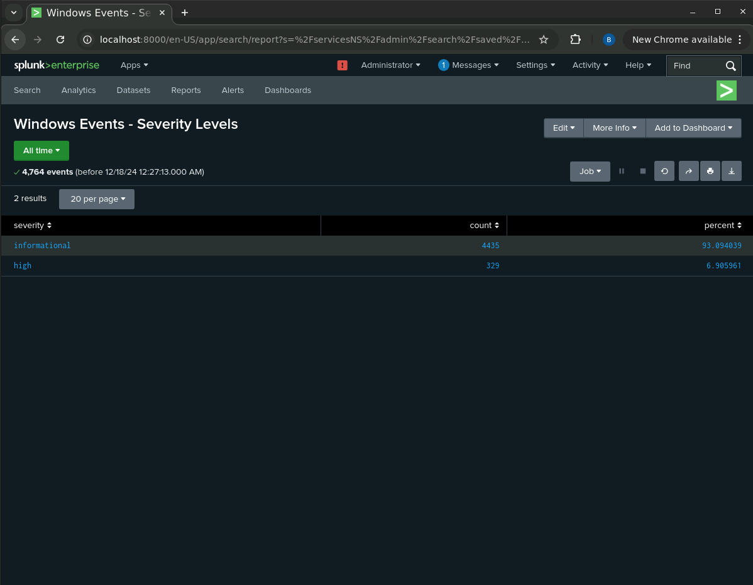
Images of Reports—Windows

Slide 9
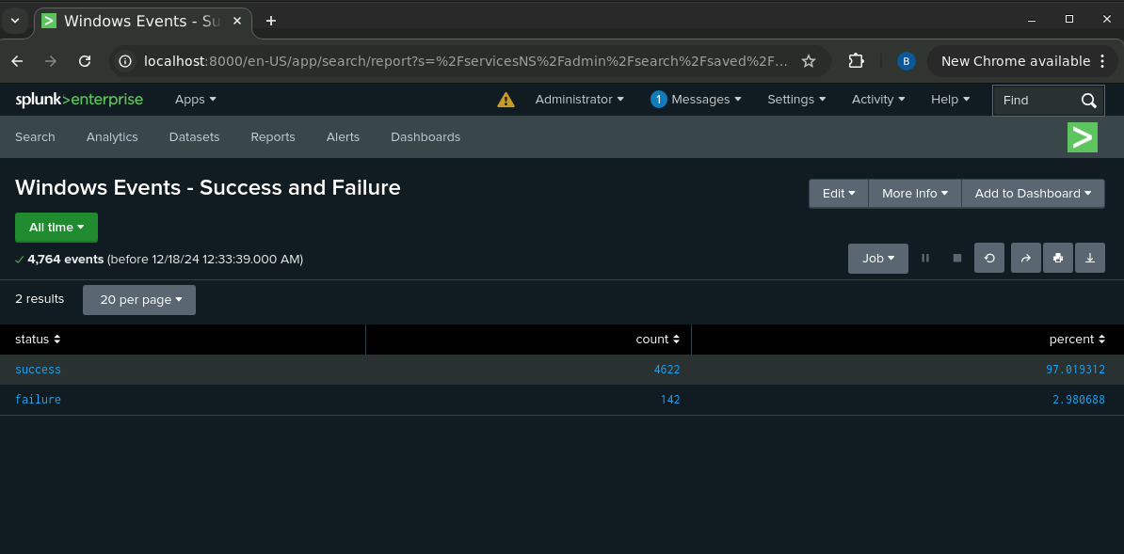
Images of Reports—Windows

Slide 10

Alerts—Windows
Designed the following alerts:
Alert Name | Alert Description | Alert Baseline | Alert Threshold
Windows Events - Failed Events | Failed events exceeds threshold of 12 failures per hour | 6 failures per hour | 12 failures per hour
JUSTIFICATION: The average number of failed Windows activities settled around 6 as our baseline and had a maximum value of 10 failed events per hour. We chose a threshold of 12 failed events per hour, double our average. Any failed events exceeding 12 per hour would suggest suspicious activity.

Slide 11
Alerts—Windows
Designed the following alerts:
Alert Name | Alert Description | Alert Baseline | Alert Threshold
Windows Events - Successful Logins Per User | Successful logins exceeds threshold of 8 per user per hour | 3 successful logins per user per hour | 8 successful logins per user per hour
JUSTIFICATION: The average number of successful logins averaged 3 successful logins per user per hour in our baseline. We noticed that the maximum number of successful logins per hour was 6. This led us to recommend a threshold of 8 successful logins per hour per user. More than 8 would be something we would want to investigate further.

Slide 12
Alerts—Windows
Designed the following alerts:
Alert Name | Alert Description | Alert Baseline | Alert Threshold
Windows Events- User Account Deletions | User account deletions exceeds threshold of 26 deletions per hour | 13 user account deletions per hour | 26 user account deletions per hour
JUSTIFICATION: When we looked at the data, we noticed an average of 13 user account deletions per hour, with a maximum of 22 user account deletions per hour. So a reasonable threshold seems to be 26 user accounts deleted per hour, double our average. Deleting user accounts at a rate exceeding 26 per hour would be indication of suspicious activity that we would want to take a closer look at.

Slide 13
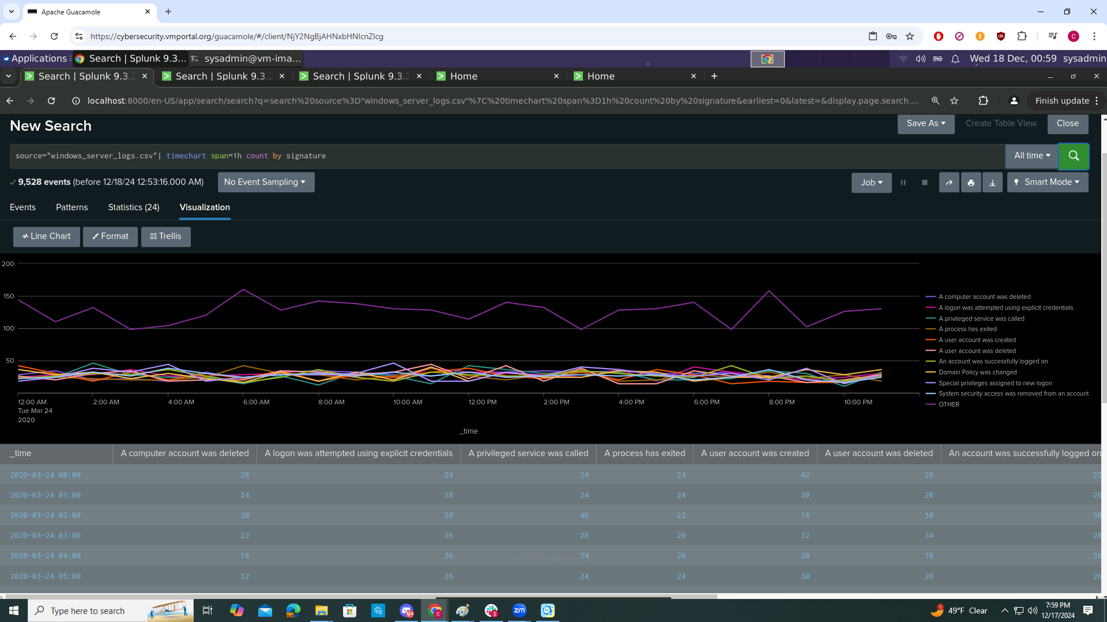
Dashboards—Windows
A line chart that displays the different “signature” field values over time.
source="windows_server_logs.csv"| timechart span=1h count by signature

Slide 14
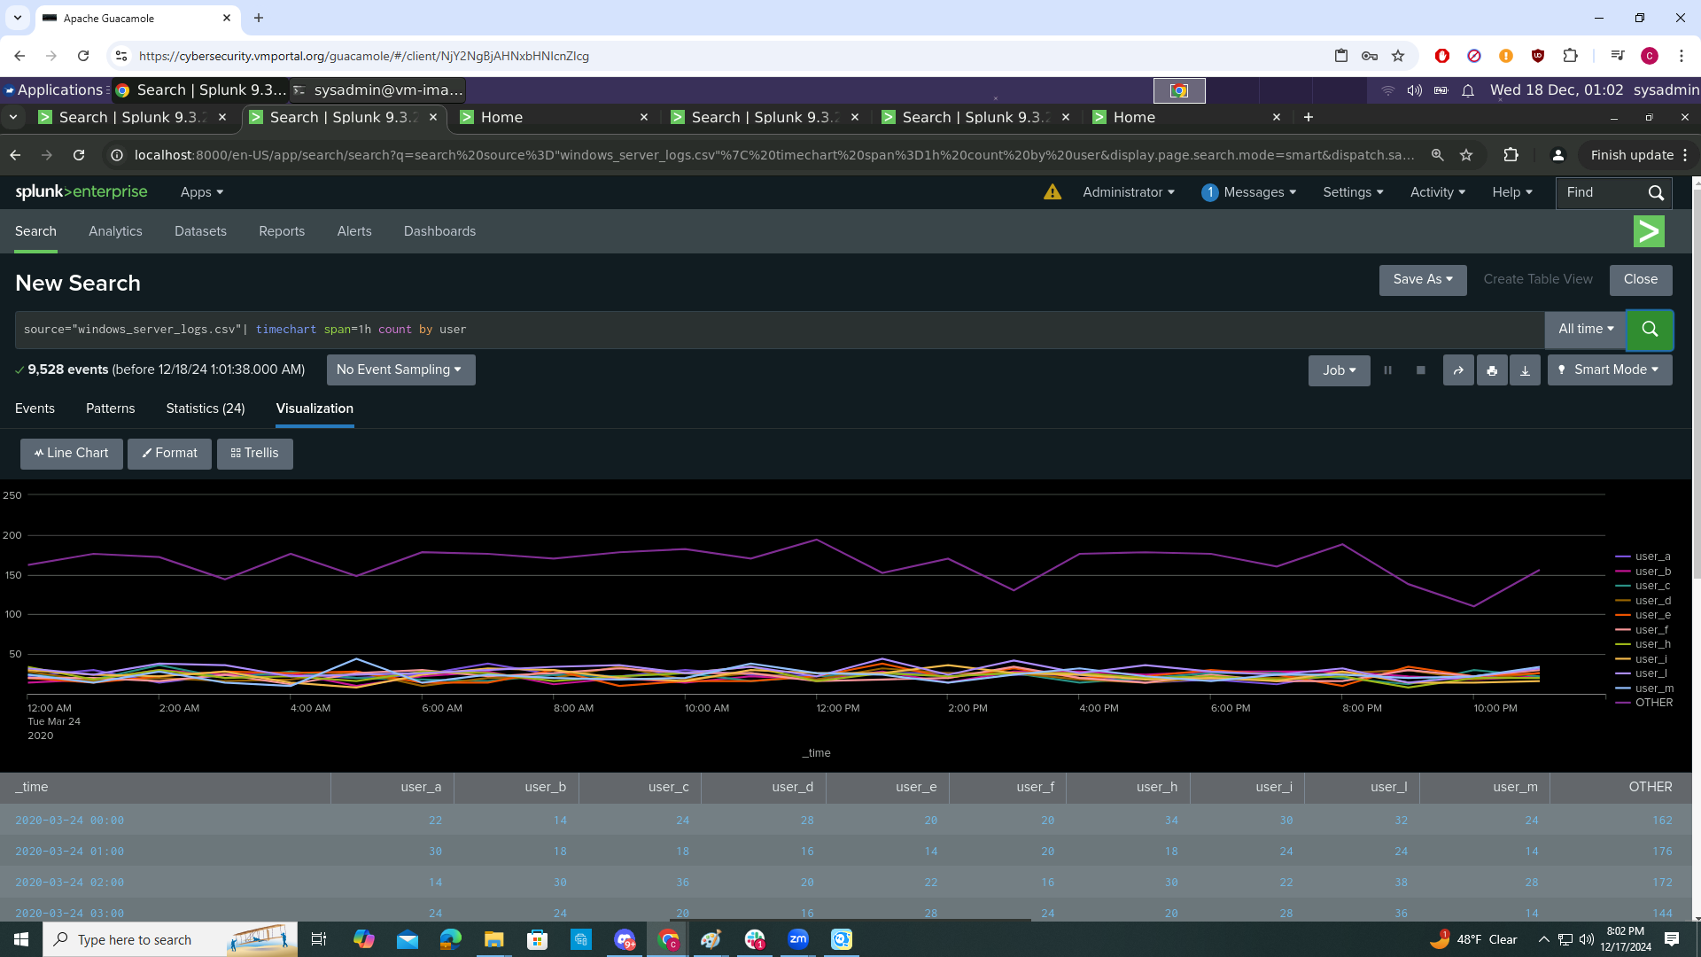
Dashboards—Windows
A line chart that displays the different “user” field values over time
source="windows_server_logs.csv"| timechart span=1h count by user

Slide 15
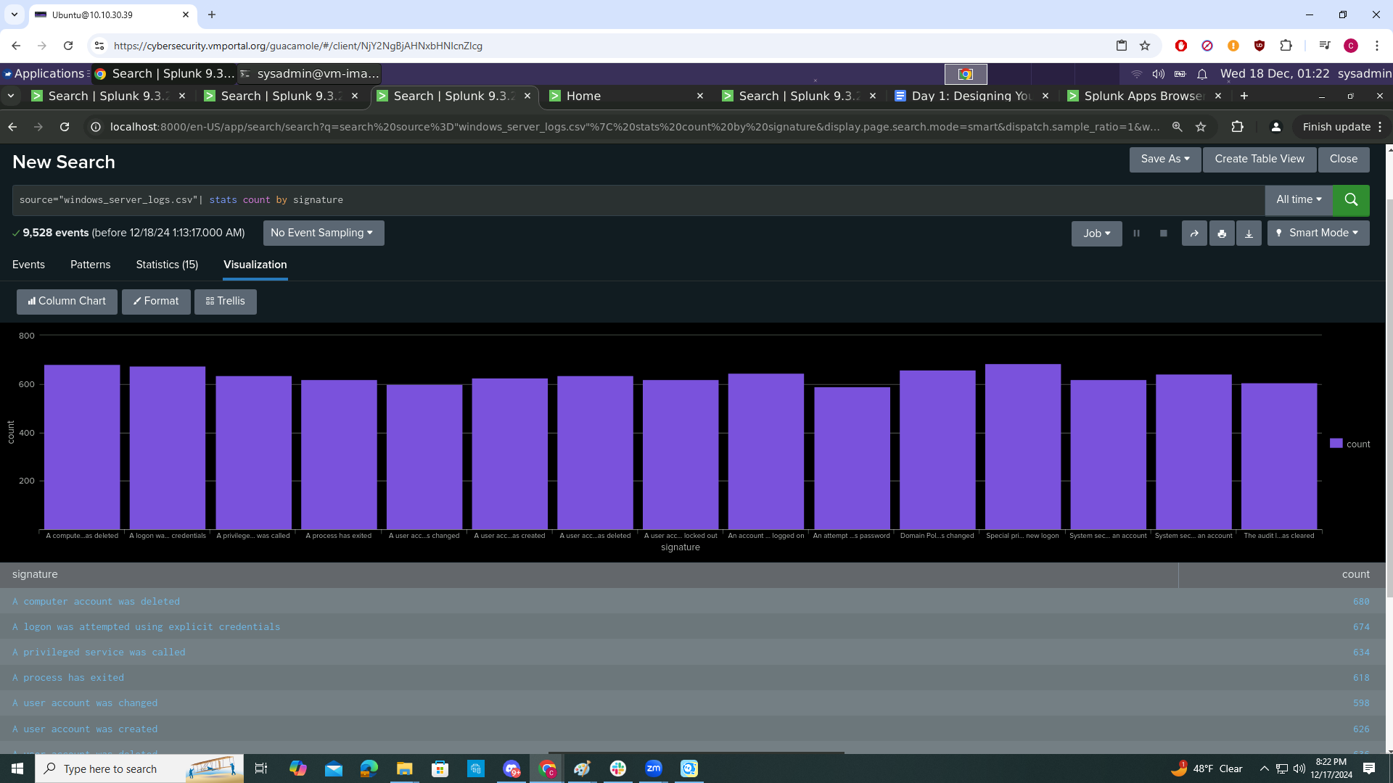
Dashboards—Windows
Any visualization that illustrates the count of different signatures
source="windows_server_logs.csv"| stats count by signature

Slide 16
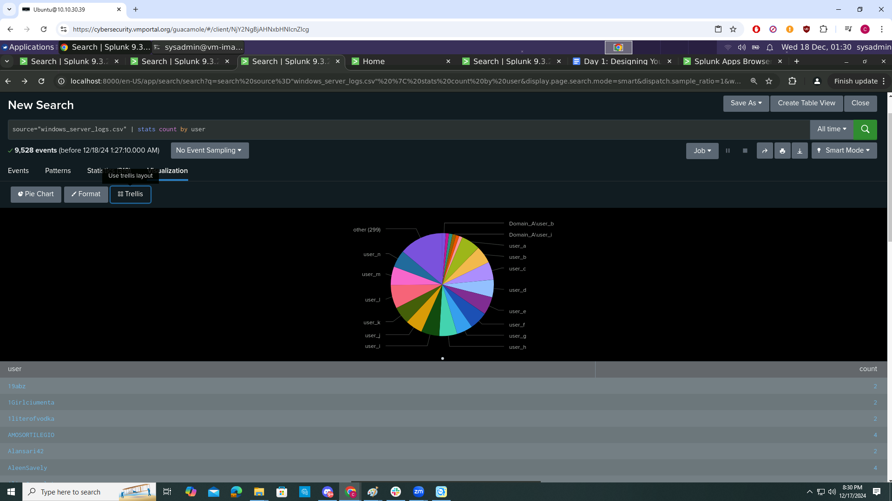
Dashboards—Windows
Any visualization that illustrates the count of different users
source="windows_server_logs.csv" | stats count by user

Slide 17
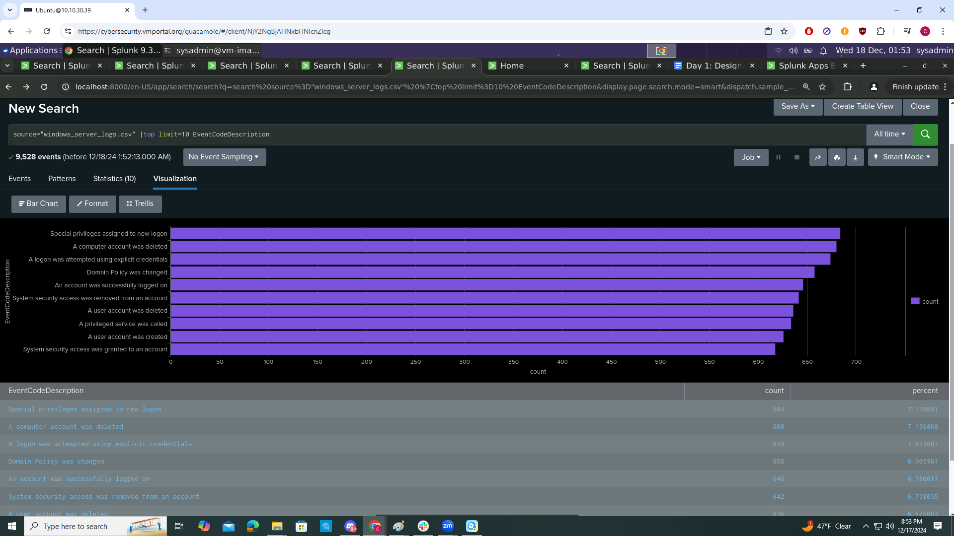
Dashboards—Windows
Any single-value visualization of your choice that analyzes any single data
source="windows_server_logs.csv" |top limit=10 EventCodeDescription

Slide 18
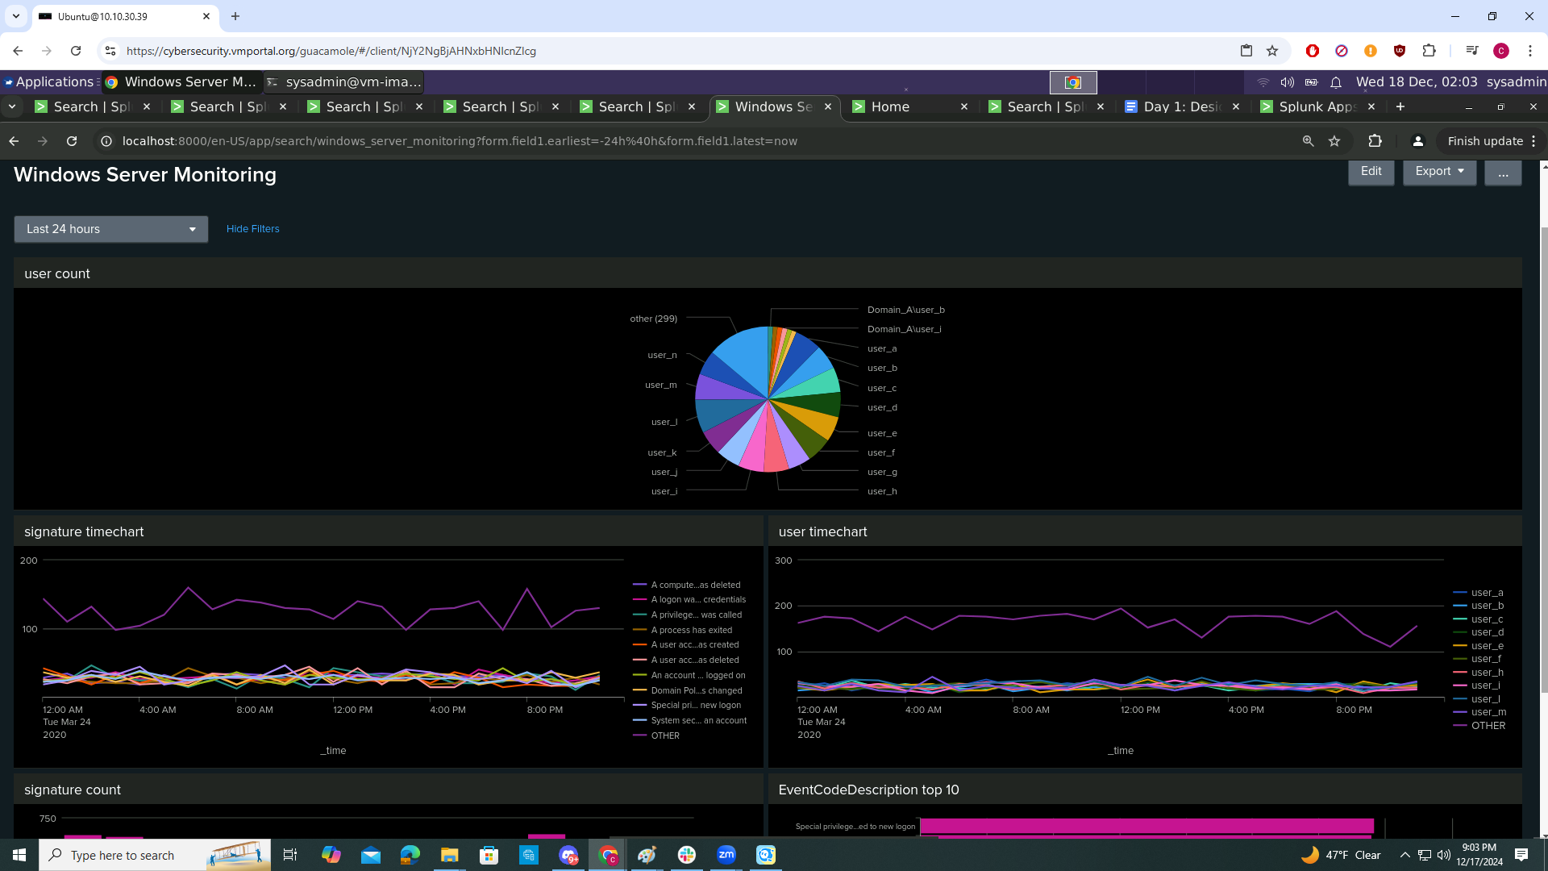
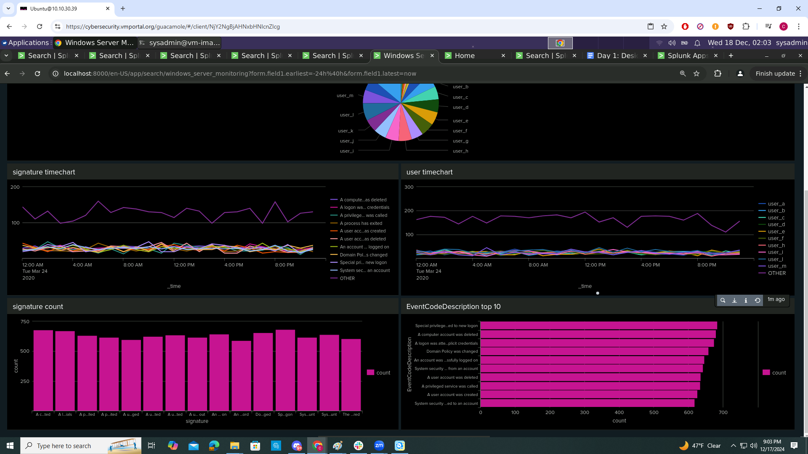
Time range for all visualizations

Slide 19
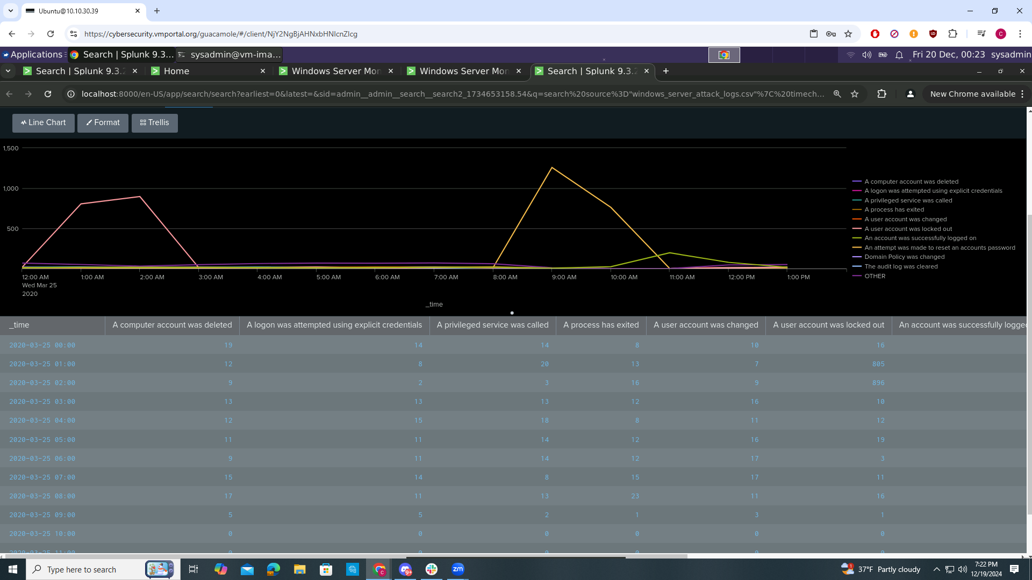
Dashboards—Windows
dashboard for the attack logs on signatures and what stands out is “A user account was locked out” and “An attempt was made to reset an accounts password”

Slide 20
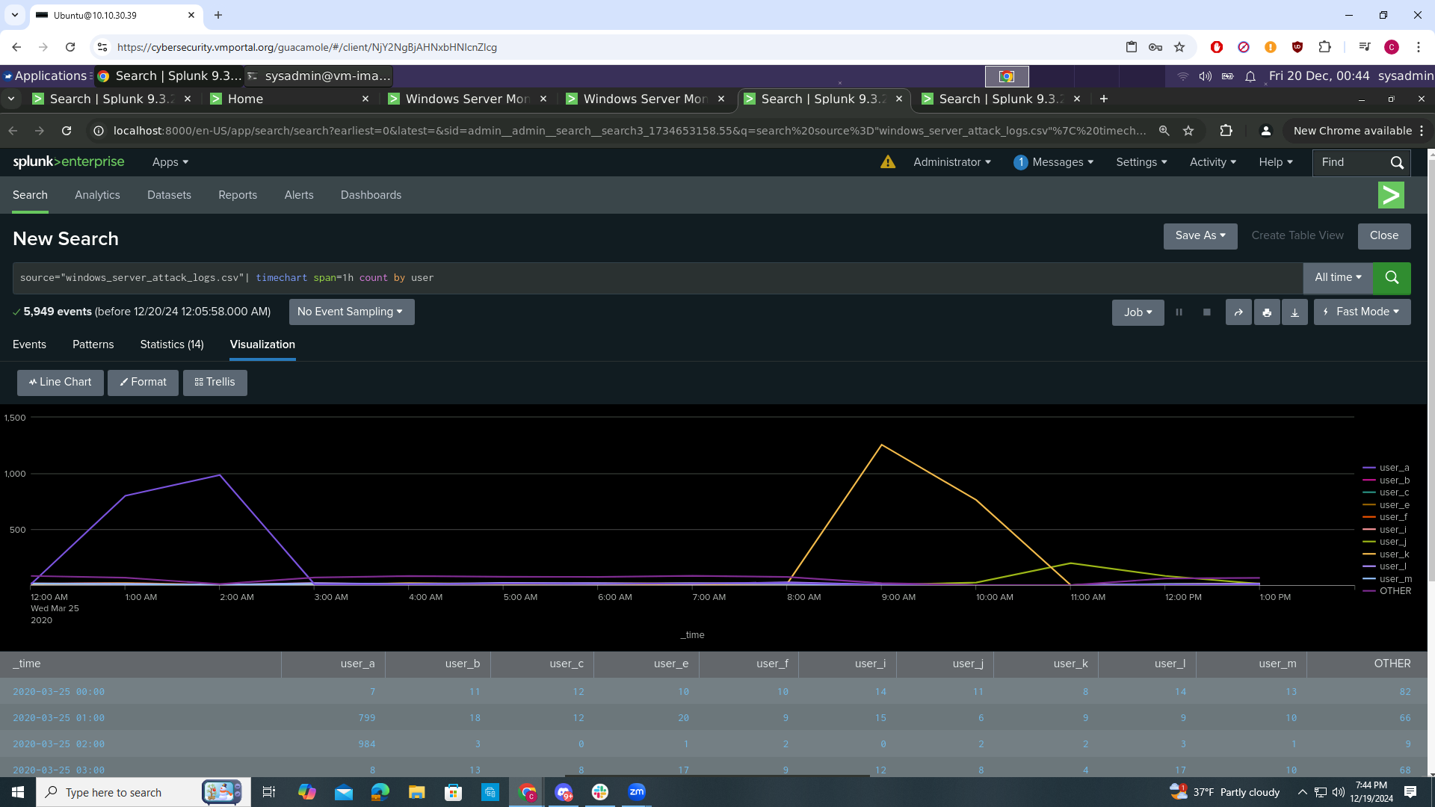
Dashboards—Windows
dashboard for the attack logs for user and what stands out is user_a and user_k

Slide 21
Apache Logs
‹#›

Slide 22
Reports—Apache
Designed the following reports:
Report Name | Report Description
HTTP Methods | A detailed report will offer valuable insights into the nature and patterns of HTTP activity being requested on VSI's web server, helping to analyze traffic, identify trends, and ensure optimal server performance.
Top 10 Domains | A report that highlights the top 10 domains referring traffic to VSI's website, providing insights into key sources driving visitors and helping to evaluate referral performance and engagement.
Count of HTTP Response Code | A report that presents the count of each HTTP response code, offering a clear overview of server activity and helping to identify trends, potential issues, and overall performance metrics.

Slide 23
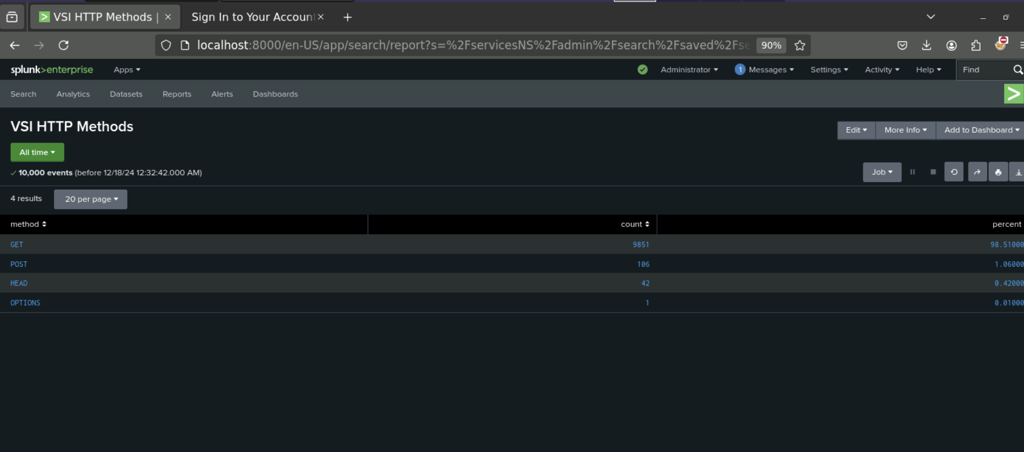
Images of Reports—Apache

Slide 24
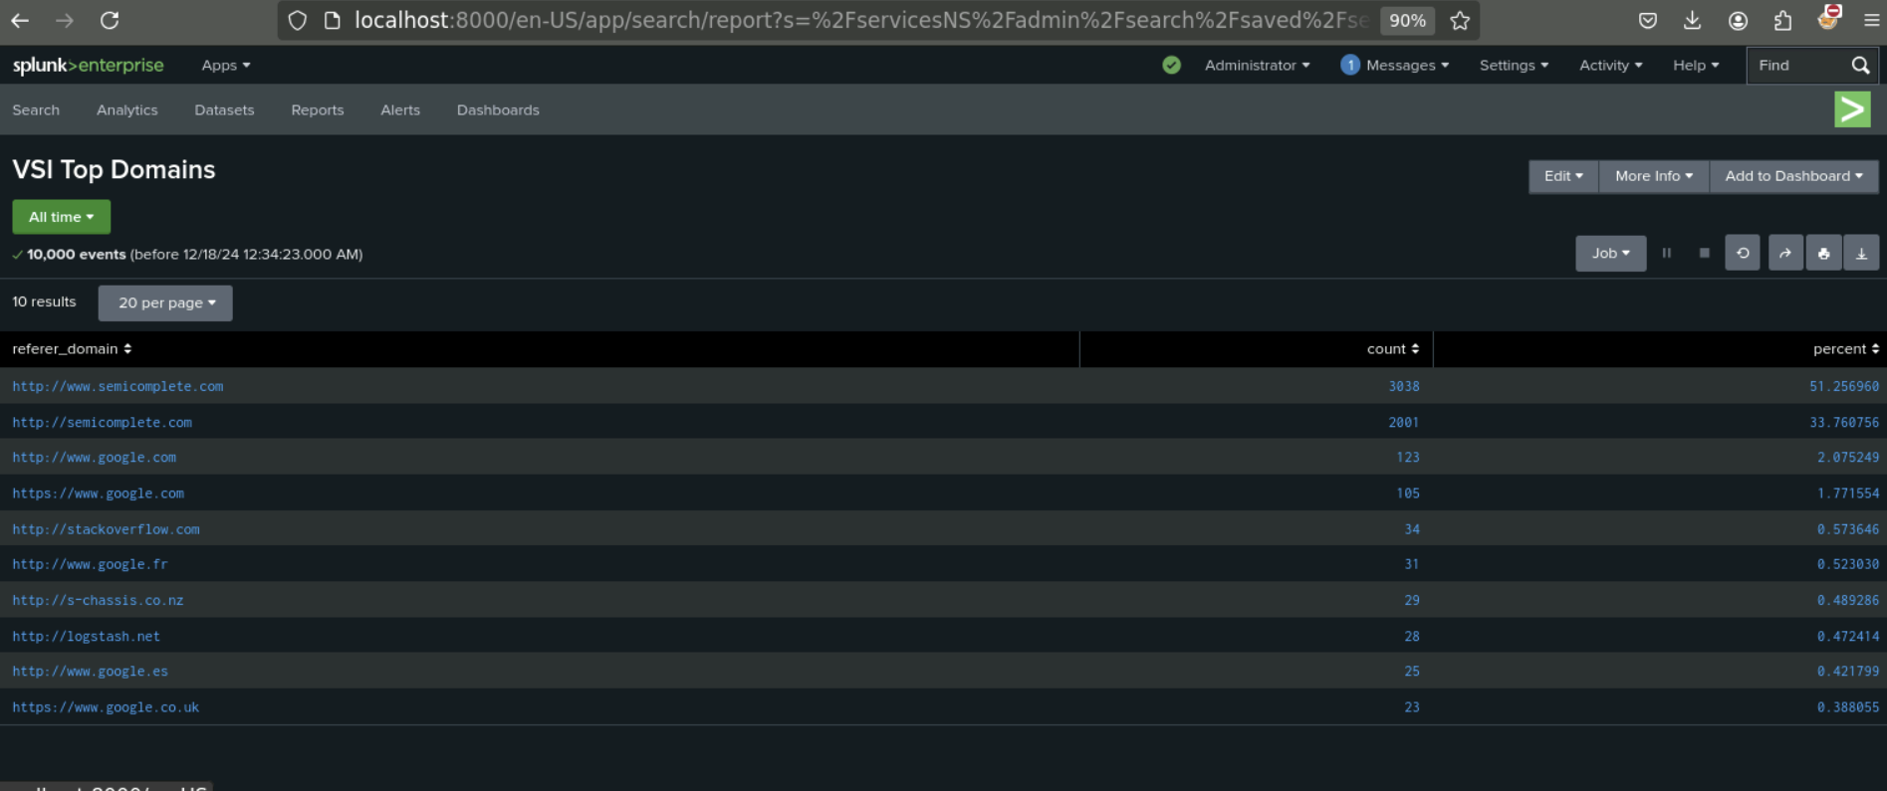
Images of Reports—Apache

Slide 25
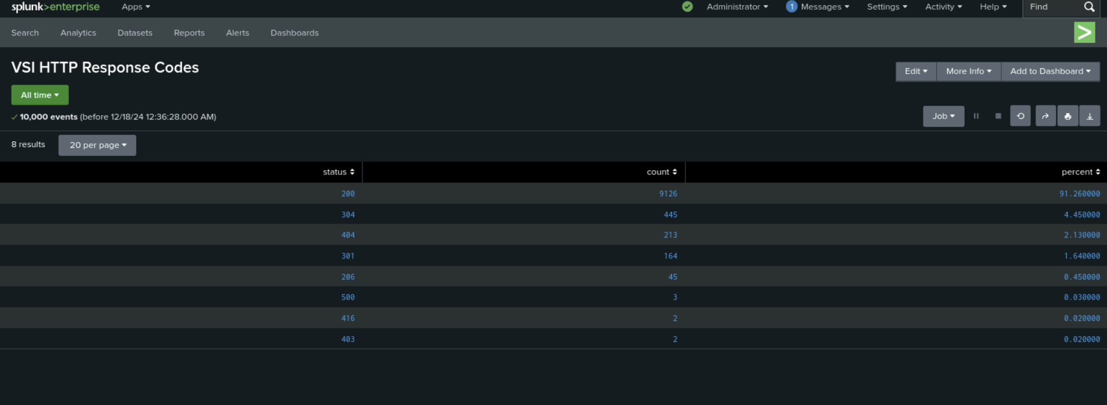
Images of Reports—Apache

Slide 26
Alerts—Apache
Designed the following alerts:
Alert Name | Alert Description | Alert Baseline | Alert Threshold
VSI Non-US Activity | Alert if the hourly activity from any country besides the US exceeds the threshold. | 80 | 170
JUSTIFICATION: 80 events seemed standard for the logs, but 170 seemed excessive for an hour. Seeing the number higher than 170 would indicate an issue.

Slide 27
Alerts—Apache
Designed the following alerts:
Alert Name | Alert Description | Alert Baseline | Alert Threshold
VSI HTTP Response Codes | Alert if the hourly count of HTTP Post methods exceed the threshold. | 3 | 12
JUSTIFICATION: From the information provided in the logs an average hour is anywhere between 1 and 4, with nothing being higher than 7. Setting the threshold at 12 seems like it would be out of reach for a normal hour.

Slide 28
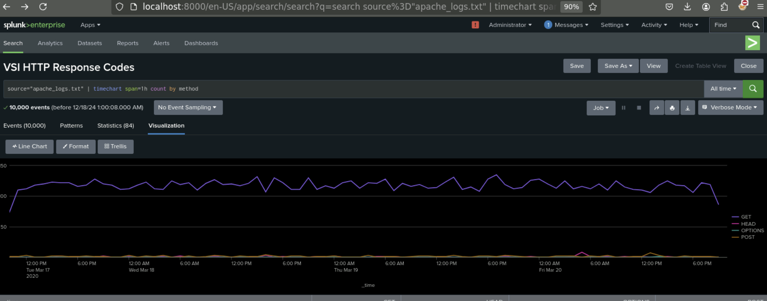
Dashboards—Apache
VSI - HTTP Response Codes

Slide 29
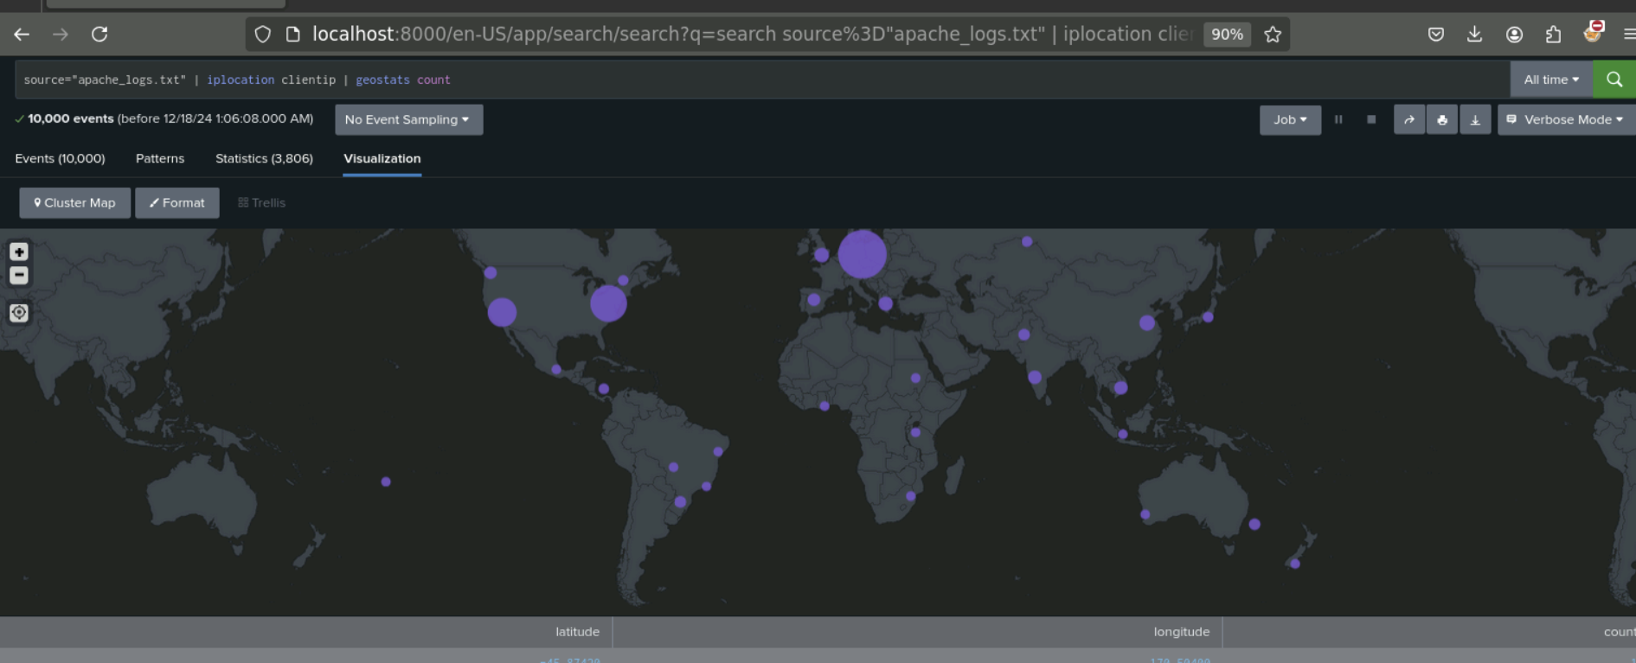
Dashboards—Apache
Place image here
VSI - GeoLocation by Client IP

Slide 30
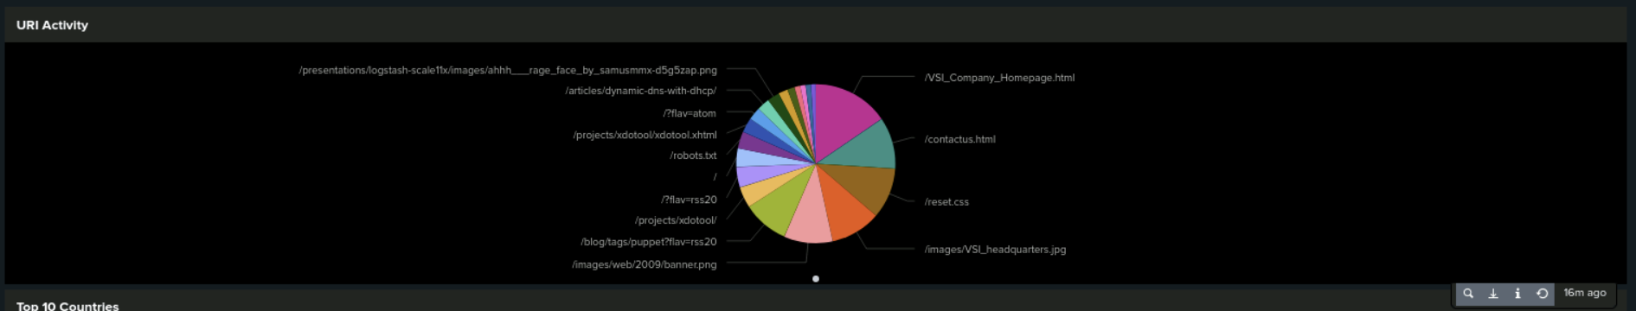
Dashboards—Apache
VSI - URI Activity

Slide 31
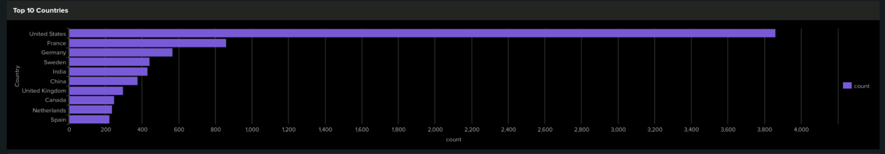
Dashboards—Apache
VSI - Top 10 Countries

Slide 32
Attack Analysis
‹#›

Slide 33

Attack Summary—Windows
Summarize your findings from your reports when analyzing the attack logs.
Report Analysis for Severity
The “Informational” severity decreased from 93% to 79%, while the “High” severity increased from 6% to 20%. The huge jump in the “High” severity category seems a clear indicator that something is amiss, and needs to be investigated more thoroughly.
Report Analysis for Failed Activities
The total count of “failed activities” decreased from 142 events (2%) to 93 events (1%). While the raw numbers didn’t indicate any clear attack (since they actually decreased), it may be that this report just isn’t the best indicator of attack.

Slide 34
Attack Summary—Windows
Summarize your findings from your alerts when analyzing the attack logs. Were the thresholds correct?
In summary, two users stood out in our findings: User_A and User_K., who had high activity volume. Some of the activities detected were: account lockout, attempt to reset passwords, and unusual access times.
Failed Events: On March 25, 2020, at 8:00 AM, 35 failed events occurred, surpassing the 12-event threshold and triggering an alert. To minimize false positives while still detecting potential attacks, it’s recommended to raise the threshold to 15.
Successful Logins: On March 25, 2020, at 2:00 AM, user_a logged in 11 times, exceeding the 8-login per hour threshold and triggering our alert. The threshold seems appropriate for detecting suspicious activity, but we recommend enhanced by adding separate alerts for login attempts during "off hours."
Severity Changes: A significant increase in "high" severity events was detected, rising from 329 to 1111.
Suspicious activity was noted on User_A between 12:00 AM to 3:00 AM and User_K between 8:00 AM to 11:00 AM. Their respective peak counts are as follows: User_A (peaking at 896 successful logins/hour) and User_K (peaking at 1258 successful logins/hour).

Slide 35
Attack Summary—Windows
Dashboard(s) summary when analyzing the attack logs.
In summary, The data was analyzed for unusual activity across different signatures and user behavior. A time chart analysis was conducted for key events, focusing on user account lockouts and password reset attempts, which showed suspicious activity during specific timeframes.
Time chart of signature:On March 25, 2020, “User account was locked out” between 12am-3am and "an attempt was made to reset an account's password" from 8am - 11am.
Users: Suspicious activity was noted on March 25, 2020, with user_a active from 12:00 AM to 3:00 AM, peaking at 984, and user_k active from 8:00 AM to 11:00 AM, peaking at 1256 occurrences of the “An attempt was made to reset an accounts password” signature.
Signature analysis: The data for "a user account was locked out" and "an attempt was made to reset an account password" align with other information from the dashboard. The charts show a clear spike in activity for both user_a and user_k at the same times across all metrics.

Slide 36

Attack Summary—Apache
Summarize your findings from your reports when analyzing the attack logs.
For the POST, HTTP method, there was a significant increase.
Examination of the referrer domains showed no suspicious activity, but more extensive analysis is needed.
The HTTP Response codes showed 404 increasing from 2% to 15%.

Slide 37
Attack Summary—Apache
Summarize your findings from your alerts when analyzing the attack logs. Were the thresholds correct?
Our thresholds were correct, we showed a jump in international activity between 8pm and 9pm.
Between 7pm and 9pm, we detected a suspicious volume of HTTP POST activity. It peaked at 1,296. Our threshold was correct and would have triggered an alert.

Slide 38
Attack Summary—Apache
Summarize your findings from your dashboards when analyzing the attack logs.
Our time chart of HTTP methods revealed suspicious volume of GET and POST methods. GET peaked at 729 from 5pm to 7pm on March 25, 2020. POST peaked at 1296 from 7pm to 9pm on the same day.
Our cluster map revealed suspicious activity from Kiev (439), Kharkiv (433), D.C. (714) and NYC (549).
From the logs provided our URI data indicated “/VSI_Account_logon.php” as having suspiciously high volume.

Slide 39
Recommendation To Begin Using
“Export Everything” Add-On App
with Splunk
‹#›

Slide 40

Splunk Add-On: Export Everything - by Deductiv
Summary
This add-on exports your Splunk search results to remote destinations so you can do more with your Splunk data. Search commands and alert actions export your data to multiple destination types, with any fields, in nearly any format.
Features
File-Based Destinations
- AWS S3-Compatible Object Storage (S3, Google Cloud Storage, MinIO)
- Azure Blob & Data Lake Object Storage
- Box.com Cloud Storage
- Windows/SMB File Shares
- SFTP Servers
Formats
JSON, raw text, key/value pairs, CSV, TSV, and more!

Slide 41

Splunk Add-On: Export Everything
In order to help protect VSI, we have set up Export Everything to export the Splunk data to an Amazon S3 bucket in JSON format.
This helps in the following scenarios:
It creates offsite cloud-based backups of the Splunk log files. So if there was ever an issue with the Splunk server itself, there would still be offsite backups of the security data.
By changing the output format from CSV to JSON, the data can be used more programmatically such as by other tools or by data analysts.
It allows other systems/analysts to access the logs via the cloud without affecting the real-time performance of the Splunk server. This is especially useful in a “data lake” environment.

Slide 42
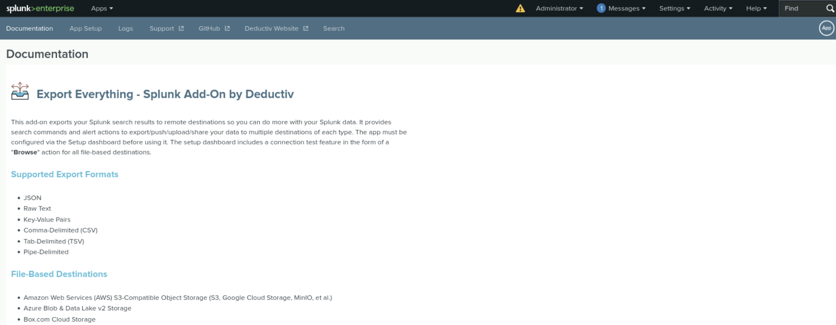
Splunk Add-On: Export Everything
[Images for add-on app]

Slide 43
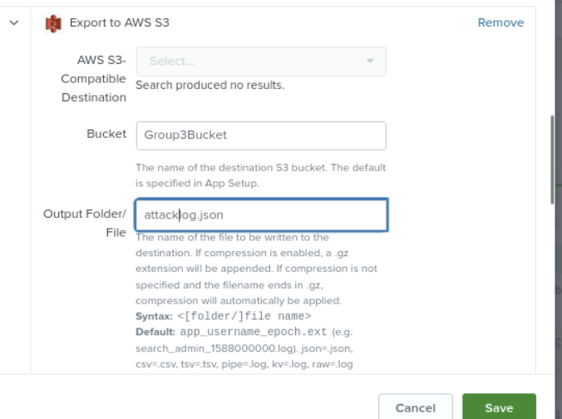
Splunk Add-On: Export Everything
Our configuration of Export Everything to export to our Amazon S3 bucket “Group3Bucket”, in JSON format, to a file named attacklog.json. In a live Splunk environment, we would configure rotating log file names rather than something static as we had to do here.

Slide 44


Logs Analyzed
Windows Logs
Apache Logs
1
2
This server hosts the intellectual property related to VSI's next-generation virtual reality programs, encompassing critical assets and proprietary information essential to their development and innovation.
This server contains the logs for VSI's main public-facing website, vsicompany.com, which serves as the primary platform for external communications and user interactions.

Slide 45
Summary and Future Mitigations
‹#›

Slide 46
Project 3 Summary
What were your overall findings from the attack that took place?
Our findings indicate that on March 25th VSI had multiple attacks on both servers. These attacks were mostly Bruteforce password spamming from different regions of the world.
To protect VSI from future attacks, what future mitigations would you recommend?
VSI should introduce a MFA (multi-factor authentication) to their website
Create a lock for over 3 failed password attempts.
VSI should use the “Export Everything” Add-On for Splunk. Exporting data to Amazon S3 facilitates offsite backups of the security data and it enables cloud-based log analysis without impacting Splunk’s real-time performance - it will enhance VSI’s abilities to use their data more effectively.

